Slide 1
The role of Universities in reclaiming the space of African Traditional Medicine
Dr Tozama Qwebani-Ogunleye
Senior Lecturer-Project Manager, Vaal University of Technology-Dihlare Remedy
Member of the South African Young Academy of Science (SAYAS)

Slide 2
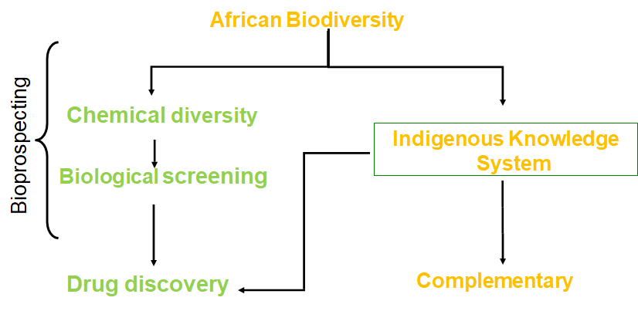
1. FOCAL POINT
Notes:
Our products fall under Complementary Medicine-IKS

Slide 3
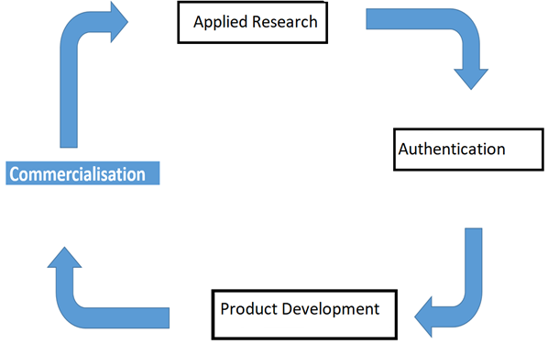
2. THE VALUE CHAIN

Slide 4
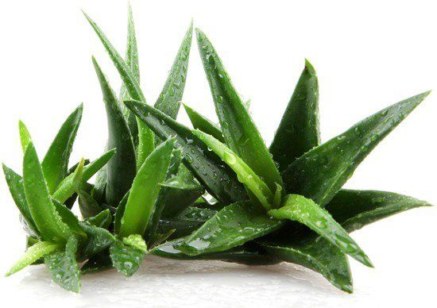
3. VISSION
To create a platform specifically purposed to rigorously evaluate medicinal plants from a scientific point of view. This will ensure credibility in the scientific fraternity and the consumer market.

Slide 5
4. MISSION
To conduct interdisciplinary to transdisciplinary research which will produce practical advances in the Indigenous Knowledge Systems. Research components will focus on:
a) Chemical profiling
b) Biological screening
c) Safety testing(toxicity)
d) Reproducibility
e) Phytochemical characterization of indigenous flora found in Africa

Slide 6
5. PROBLEM INTENDING TO SOLVE
Medicinal plants have been widely used within South African communities. Several universities have studied plants and their use and although this research has done much to elucidate the use, the research has been curtailed in several ways, including:
The universities conducted their research into the use of natural products in isolation, forgoing the opportunity to adopt an interdisciplinary and global collaborative approach.
Their efforts stopped short at the publication of their results for education and training purposes. This came at the expense of institutional recognition and a space in the accepted marketplace as a research output from Higher Education Institutions.
We seek to resolve the above two shortcomings.

Slide 7
6. STRATERGIC OBJECTIVES
SO8 Research outputs for commercialization
SO1 Lab infrastructure and Ethical clearance
SO7 Local and International Collaborations
SO2 Postgraduate student supervision
ALLIANCE
SO3 Post Docs
SO6 Secure external resources
SO5 Short Learning Programs
SO4 Publications

Slide 8
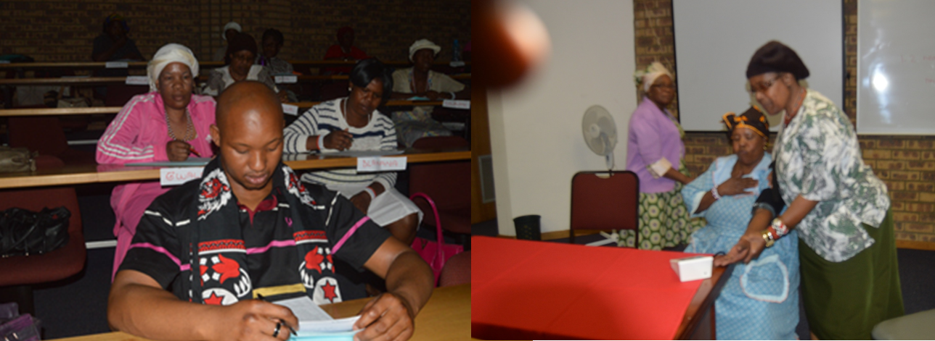
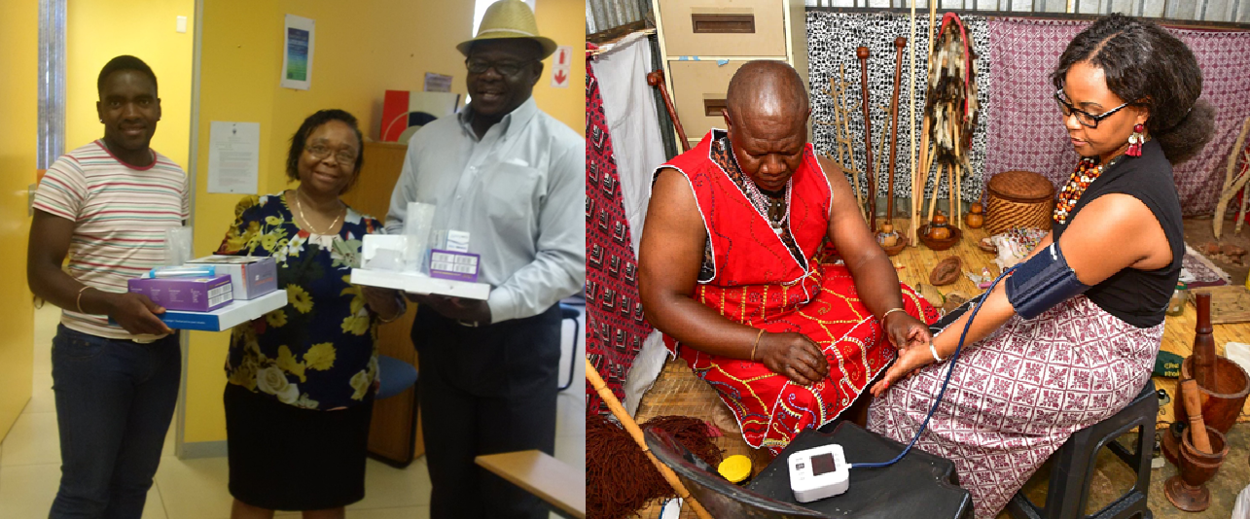

Slide 9
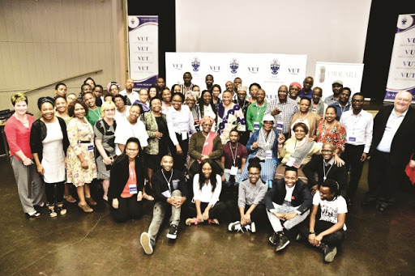

Slide 10
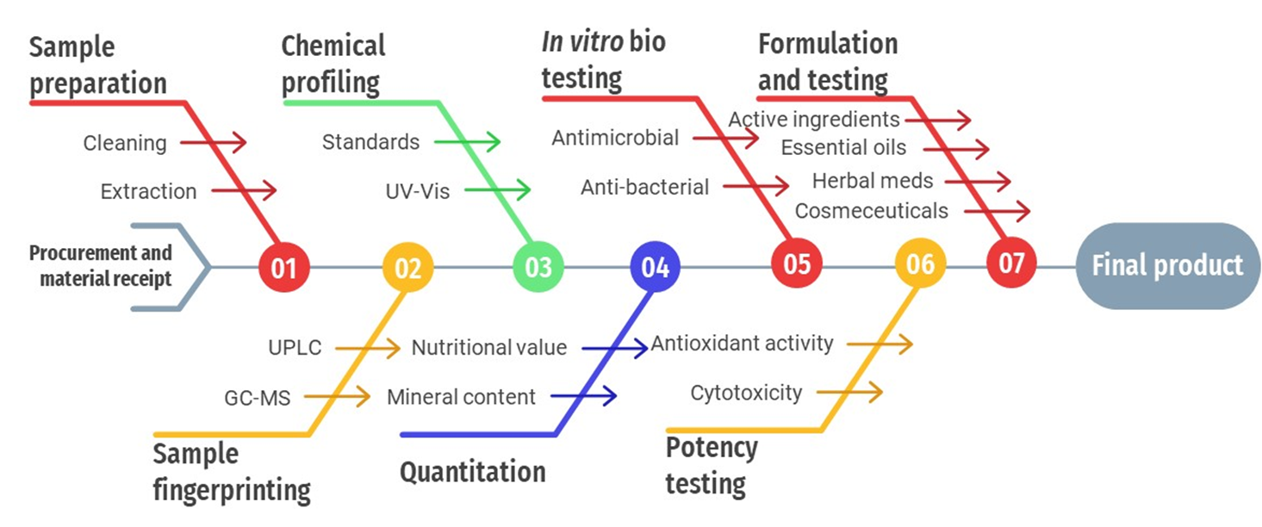
9. PROCESS FLOW

Slide 11
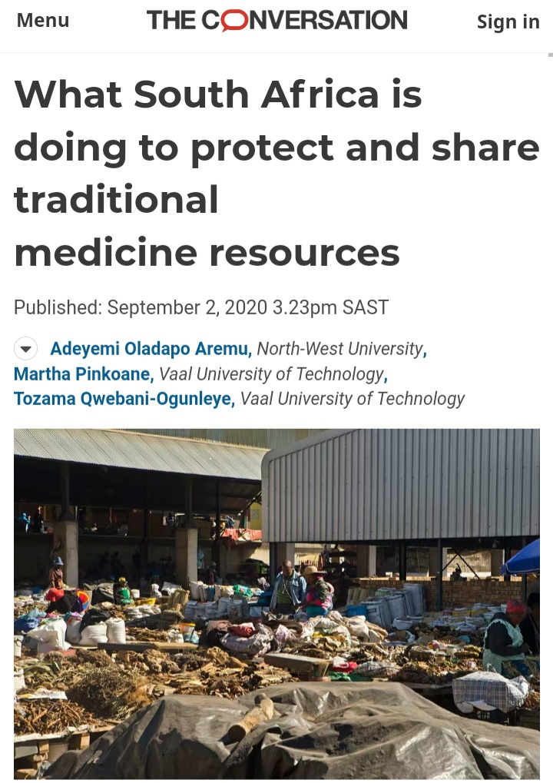


Slide 12
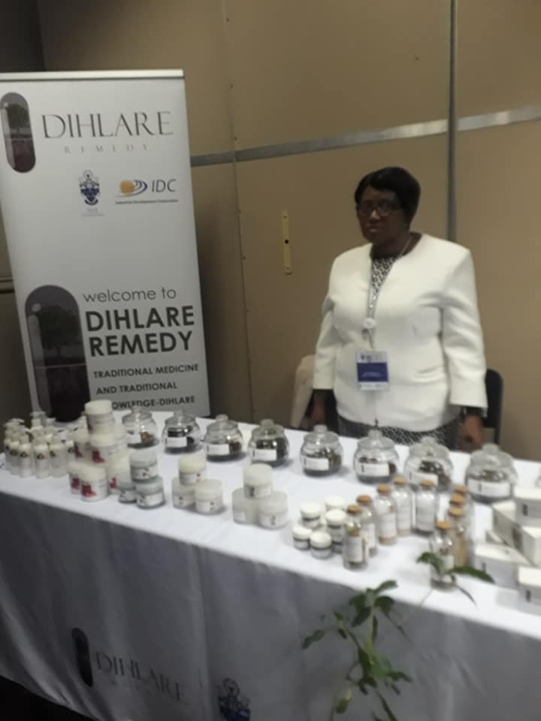
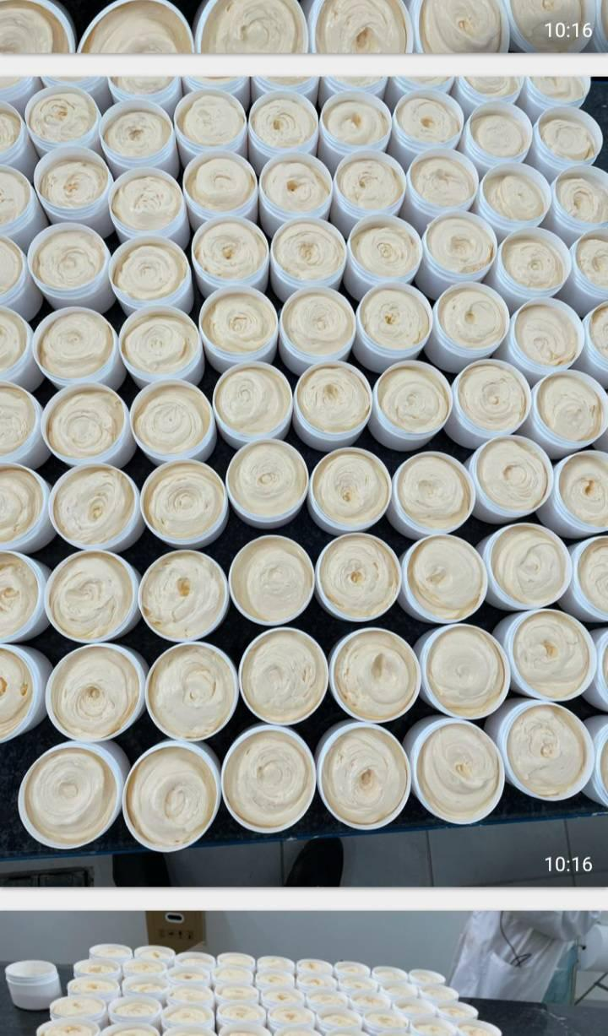

Slide 13










Slide 14

THANK YOU……

